Slide 1
AI101 MINI-PROJECT
SCHOOL OF AI & DATA ENGINEERING · IIT ROPAR
PROJECT
Sonar: Mines vs Rocks
Logistic regression with standard scaling
Classify a sonar return as a metal cylinder (mine) or a rock.
TEAM 55 · MEMBERS & ROLES
Arnav Yadav
Dhiraj Kumar Yadav
Rishabh Mahar
Kashish Chhabra
2026EEB1326
2026MCB1525
2026EEB1399
2026AIB1048
Data & exploration
Preprocessing
Models & evaluation
Plots & results
Load and inspect the dataset; create class and signal summaries.
Scale features; rank correlations; select the top 20.
Train both logistic models and compare test metrics.
Create evaluation charts, confusion matrix and results table.
Team number: 55
GitHub repository URL: https://github.com/arnav-7003/AI-Project
AI101 · Mini-project
1 / 5
Notes:
Team 55. Project roles and tasks come from the supplied main.py. Member details supplied by the user: Arnav Yadav (2026EEB1326) — data and exploration; Dhiraj Kumar Yadav (2026MCB1525) — preprocessing and feature selection; Rishabh Mahar (2026EEB1399) — models and evaluation; Kashish Chhabra (2026AIB1048) — plots and results. The GitHub repository URL was not supplied.

Slide 2
AI101 MINI-PROJECT
SONAR CLASSIFICATION
Problem and data
THE QUESTION
DATASET AT A GLANCE
Can a sonar echo be classified as a mine or a rock?
208
60
labelled sonar patterns
numeric features
Each echo is represented by 60 measurements of energy across frequency bands. The model predicts the object class from that signal.
111 mines
97 rocks
Values range from 0 to 1; the dataset has no missing values.
TARGET LABELS
M = mine (metal cylinder)
R = rock
DATA SOURCE
UCI Machine Learning Repository
Connectionist Bench (Sonar, Mines vs. Rocks)
AI101 · Mini-project
2 / 5
Notes:
Dataset source: Sejnowski, T. & Gorman, R. (1988), Connectionist Bench (Sonar, Mines vs. Rocks), UCI Machine Learning Repository. https://archive.ics.uci.edu/dataset/151/connectionist%2Bbench%2Bsonar%2B DOI: https://doi.org/10.24432/C5T01Q. The repository describes 208 instances, 60 features, values in the 0–1 range, 111 mine examples, 97 rock examples, and no missing values. The supplied source maps R to 0 and M to 1.

Slide 3
AI101 MINI-PROJECT
SONAR CLASSIFICATION
Approach
01
02
03
04
05
Load
Split
Scale
Compare
Evaluate
→
→
→
→
208 rows
60 bands + M/R label
Stratified 80/20
seed = 42
StandardScaler
fit on train only
Logistic regression
all 60 vs top 20
(correlation-ranked)
Held-out test set
accuracy · precision
recall · F1
LIBRARIES
Python · pandas · NumPy · scikit-learn · Matplotlib
The scaler and feature ranking use training data only.
AI101 · Mini-project
3 / 5
Notes:
Pipeline follows the supplied main.py. It uses train_test_split(test_size=0.20, random_state=42, stratify=y), StandardScaler fit on X_train only, selects the 20 features with strongest absolute correlation to y_train, and trains two sklearn LogisticRegression models. Libraries listed are imported by main.py.

Slide 4
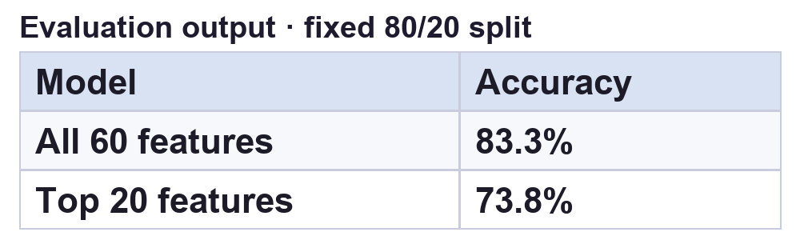
AI101 MINI-PROJECT
SONAR CLASSIFICATION
Results on one held-out split
All 60 features scored 83.3% accuracy; selecting 20 features reduced accuracy by 9.5 points.
TEST METRICS (%)
EVALUATION OUTPUT
100
83.3%
82.6%
86.4%
84.4%
80
73.8%
73.9%
77.3%
75.6%
60
ALL 60 FEATURES · ACTUAL × PREDICTED
40
Actual / predicted | Rock | Mine
Rock | 16 | 4
Mine | 3 | 19
20
0
Accuracy
Precision
Recall
F1
All 60 features
Top 20 features
Train: 166 · Test: 42 · Correct: 35/42
AI101 · Mini-project
4 / 5
Notes:
Metrics follow the fixed split in main.py: 80/20, stratified, random_state=42. The 42-row test set has 20 rocks and 22 mines. All-feature confusion matrix rows are actual [Rock, Mine] and columns predicted [Rock, Mine]: [[16, 4], [3, 19]]. Metric values were independently recomputed from the supplied sonar.all-data using the same split and the default L2 logistic-regression objective because scikit-learn and Matplotlib were unavailable in the authoring runtime. Please verify the values by running main.py with the project dependencies before submission. The evaluation table image is an output snapshot populated from this reproduction.

Slide 5
AI101 MINI-PROJECT
SONAR CLASSIFICATION
Learnings and contributions
WHAT WORKED / WHAT DIDN'T
CONTRIBUTIONS IN main.py
Worked: scaling and feature ranking use training data only.
Didn't: the top-20 model scored 9.5 points lower in accuracy than all 60 features on this split.
Limit: one dataset and one test split leave repeatability uncertain.
Arnav Yadav
Data loading and exploration
Dhiraj Kumar Yadav
Preprocessing and feature selection
Rishabh Mahar
Training and evaluation
Kashish Chhabra
Plots and results table
AI-USE DISCLOSURE
OpenAI Codex helped summarize the supplied code and draft this deck. Metric values were independently recomputed from the provided dataset using the code’s fixed split and logistic model objective; run the project with its dependencies to verify before submission.
AI101 · Mini-project
5 / 5
Notes:
The PDF brief requires an AI-use disclosure naming the tool, its use and how the work was checked. OpenAI Codex helped summarize the supplied code and draft this deck; metric values were independently recomputed from the provided dataset using the code's fixed split and logistic model objective, with a rerun recommended before submission. Contributions from main.py: Arnav Yadav (data and exploration), Dhiraj Kumar Yadav (preprocessing, correlation and feature selection), Rishabh Mahar (models and evaluation), and Kashish Chhabra (plots and results).

